Slide 1
The FQHE on parallelogram

Slide 2
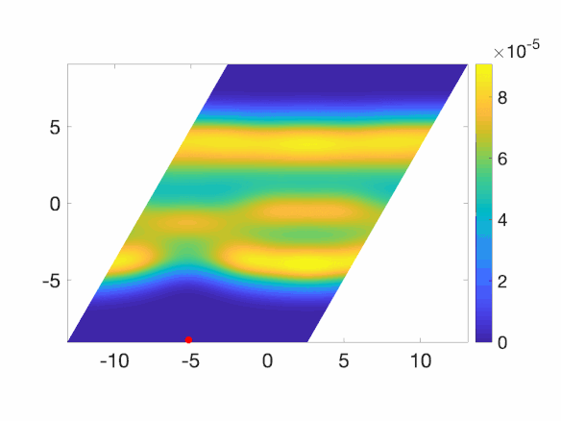
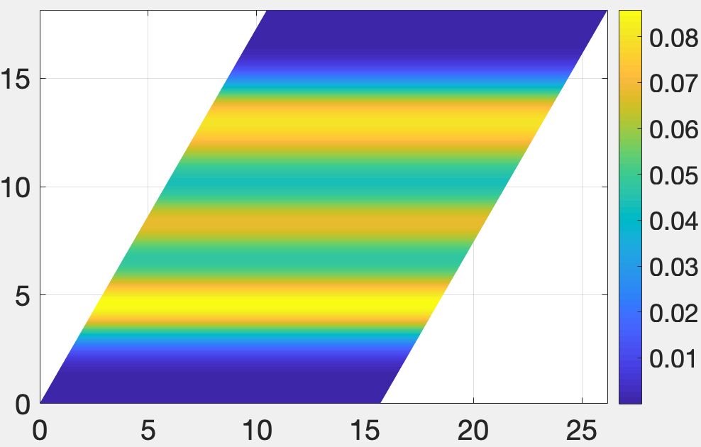
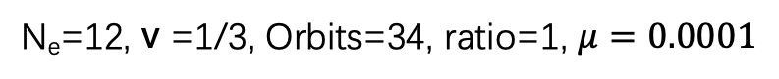
N_{e}=12, v =1/3, Orbits=34, ratio=1, $μ=0.0001$
Pair correlation function
Left Fig: electron density profile
Right Fig: Pair correlation function

Slide 3
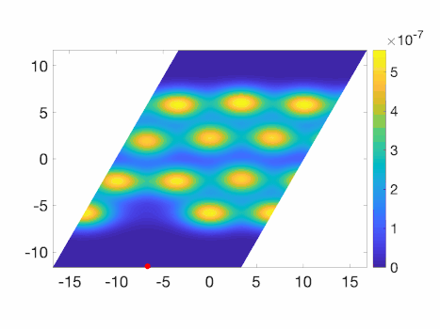
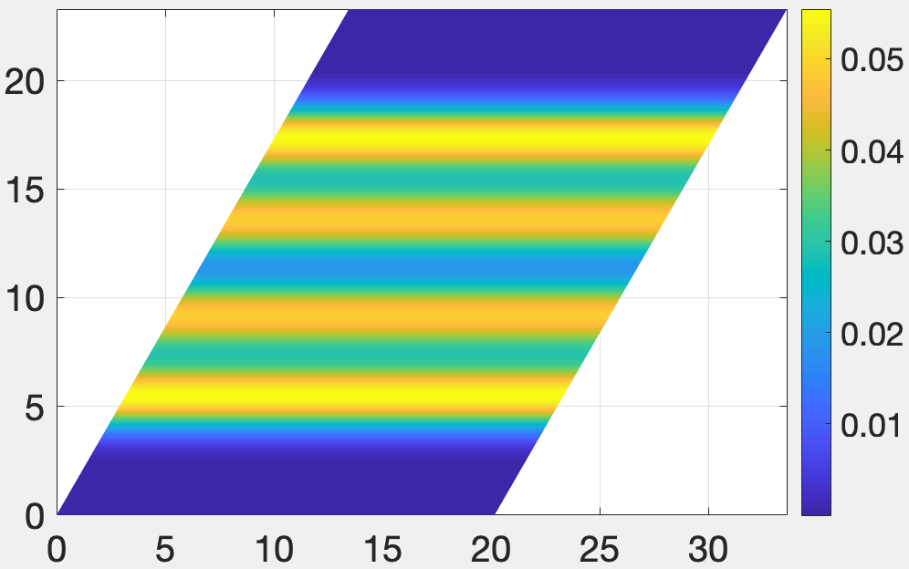
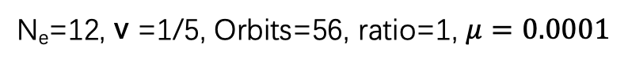
N_{e}=12, v =1/5, Orbits=56, ratio=1, $μ=0.0001$
Pair correlation function
Left Fig: electron density profile
Right Fig: Pair correlation function

Slide 4
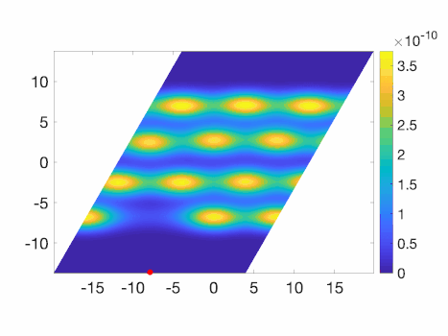
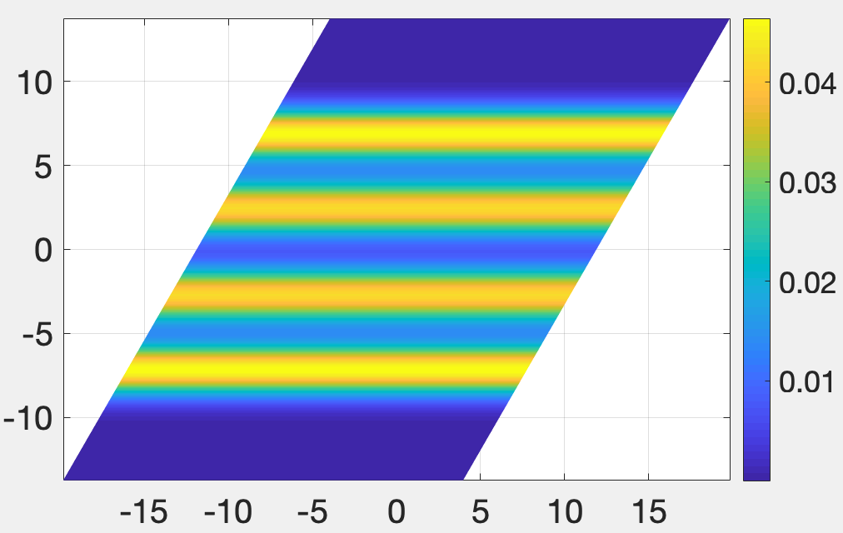
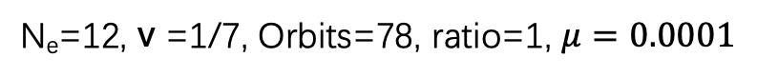
N_{e}=12, v =1/7, Orbits=78, ratio=1, $μ=0.0001$
Pair correlation function
Left Fig: electron density profile
Right Fig: Pair correlation function

Slide 5
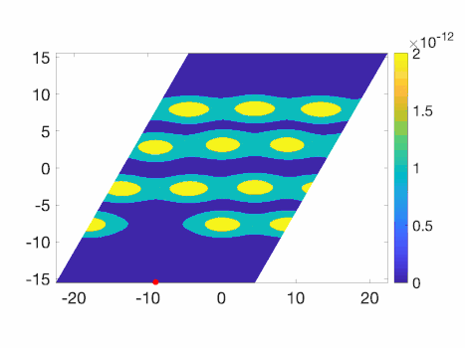
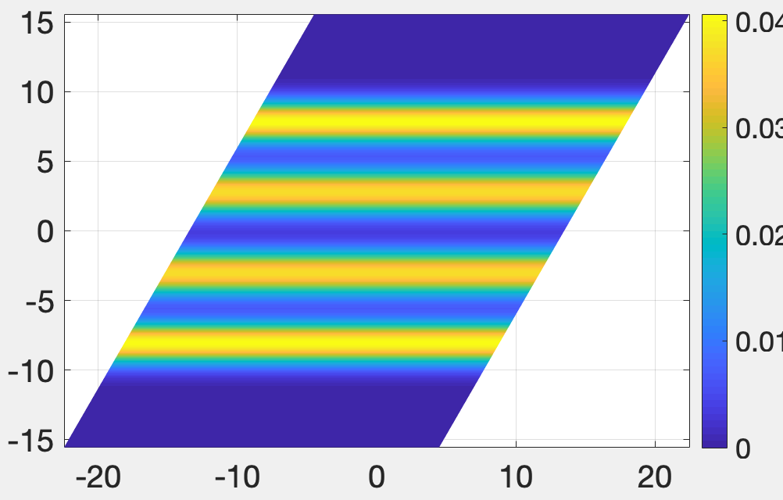
N_{e}=12, v =1/9, Orbits=100, ratio=1, $μ=0.0001$
Pair correlation function
Left Fig: electron density profile
Right Fig: Pair correlation function

Slide 6
N =6

Slide 7
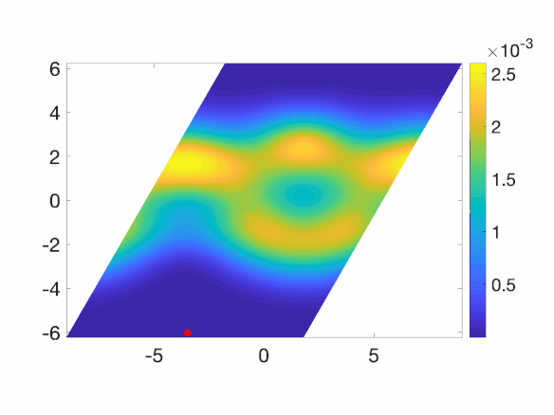
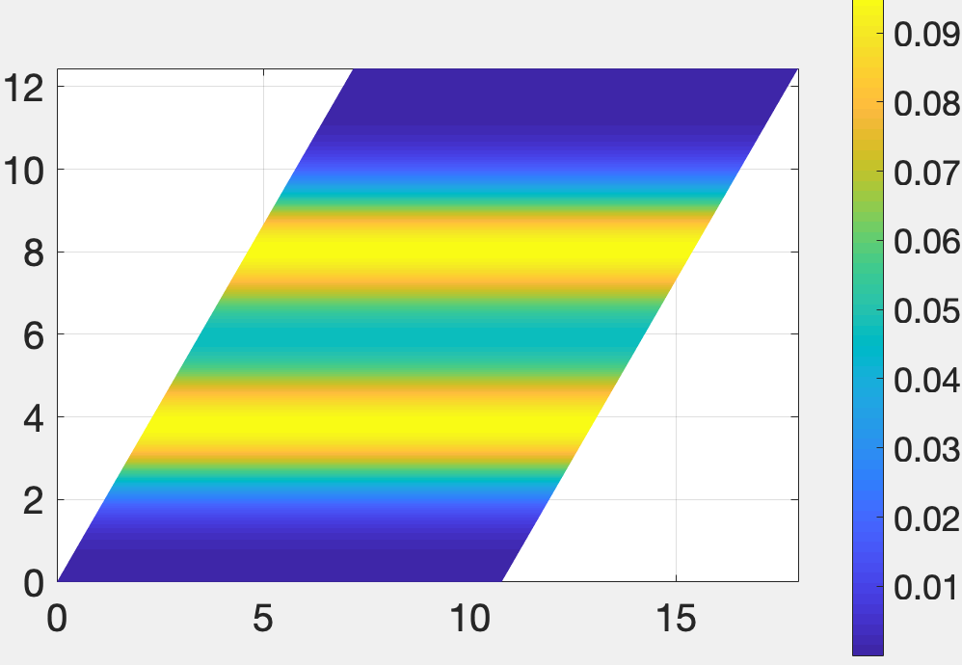
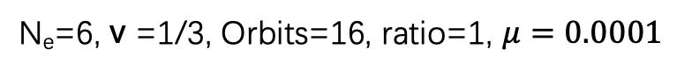
N_{e}=6, v =1/3, Orbits=16, ratio=1, $μ=0.0001$
Pair correlation function
Left Fig: electron density profile
Right Fig: Pair correlation function

Slide 8
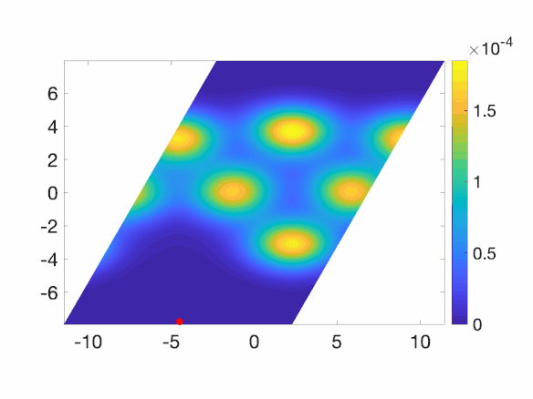
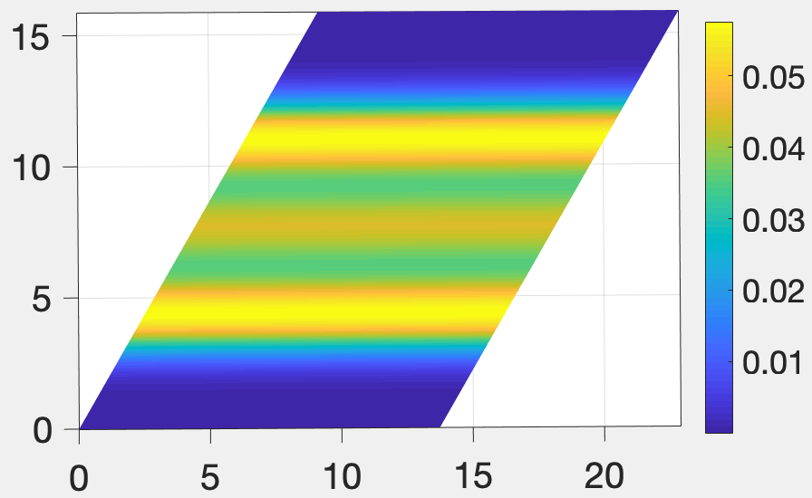
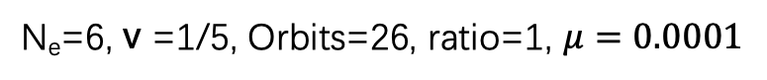
N_{e}=6, v =1/5, Orbits=26, ratio=1, $μ=0.0001$
Pair correlation function
Left Fig: electron density profile
Right Fig: Pair correlation function

Slide 9
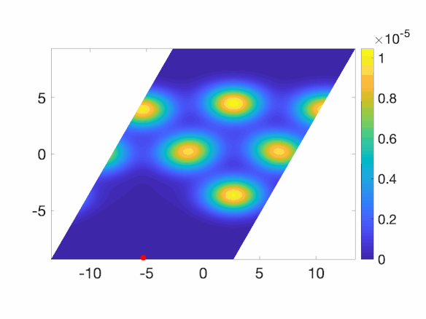
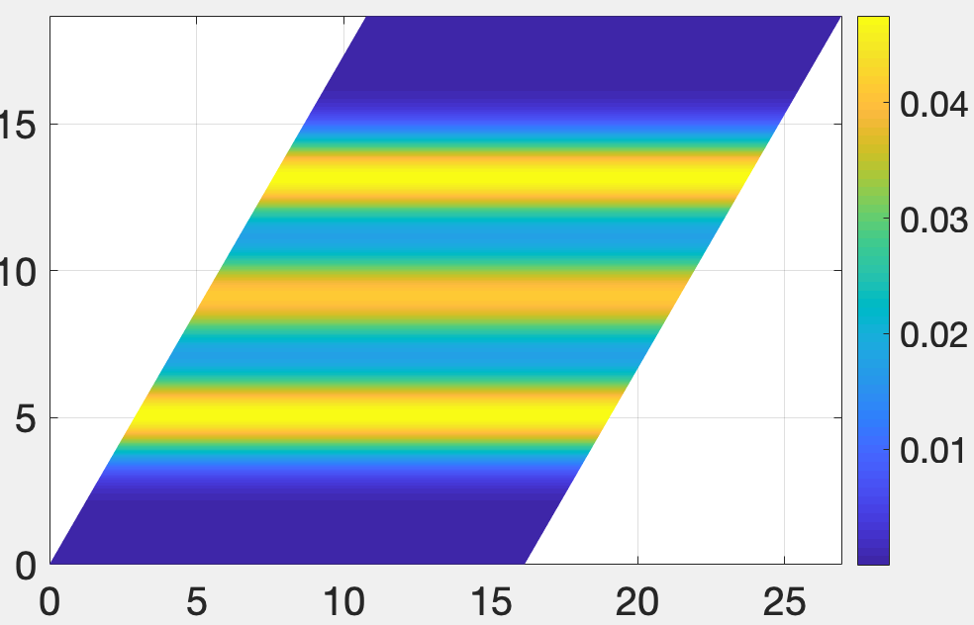
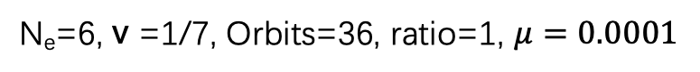
N_{e}=6, v =1/7, Orbits=36, ratio=1, $μ=0.0001$
Pair correlation function
Left Fig: electron density profile
Right Fig: Pair correlation function

Slide 10
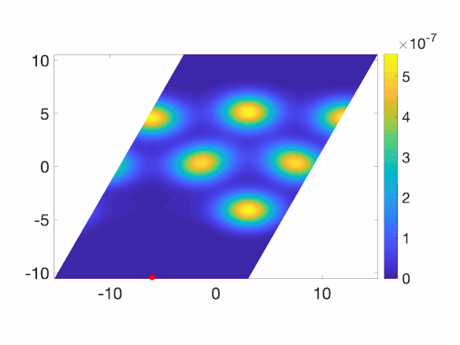
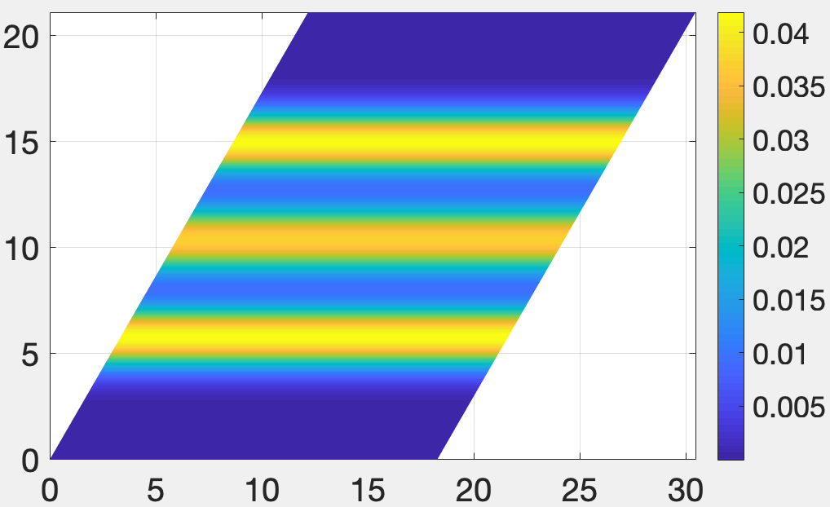
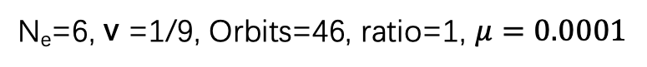
N_{e}=6, v =1/9, Orbits=46, ratio=1, $μ=0.0001$
Pair correlation function
Left Fig: electron density profile
Right Fig: Pair correlation function

Slide 11
N =9

Slide 12
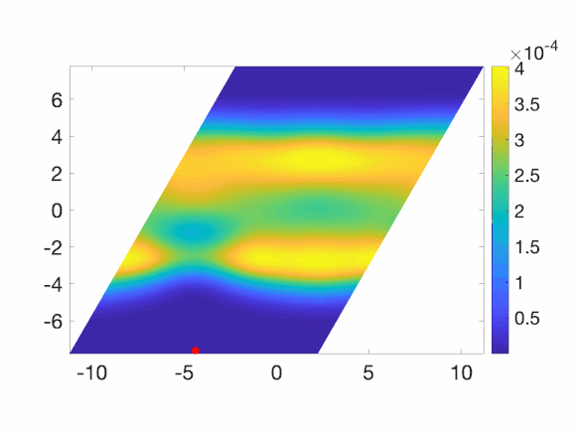
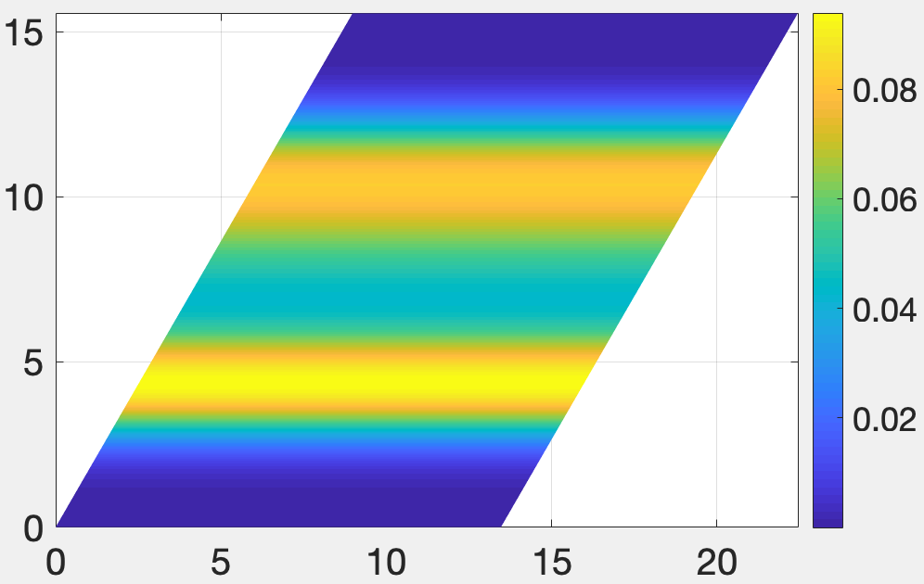
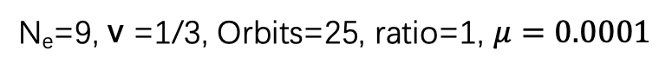
N_{e}=9, v =1/3, Orbits=25, ratio=1, $μ=0.0001$
Pair correlation function
Left Fig: electron density profile
Right Fig: Pair correlation function

Slide 13
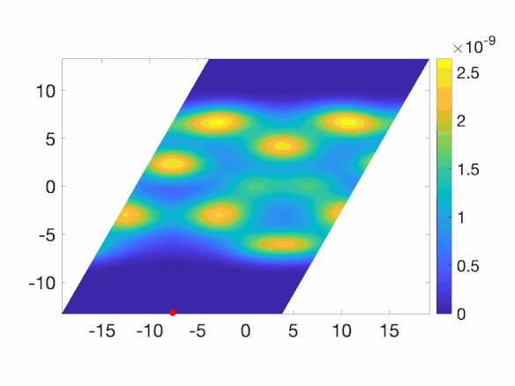
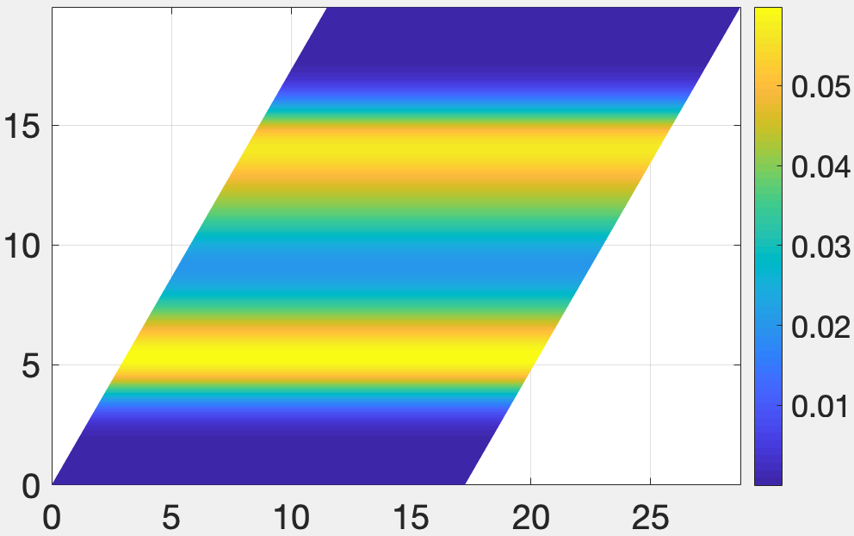
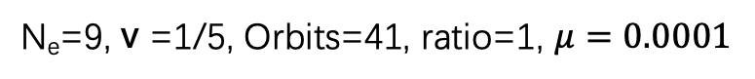
N_{e}=9, v =1/5, Orbits=41, ratio=1, $μ=0.0001$
Pair correlation function
Left Fig: electron density profile
Right Fig: Pair correlation function

Slide 14

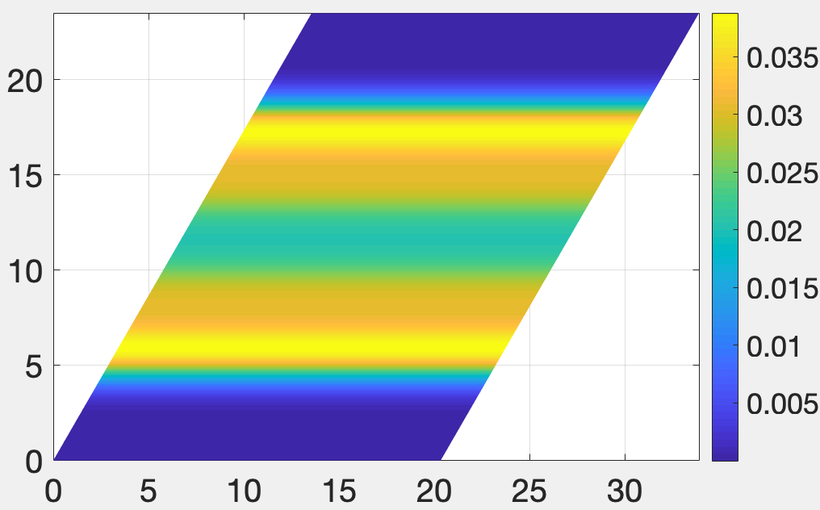
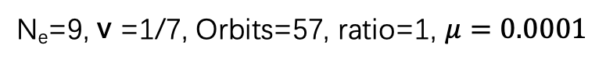
N_{e}=9, v =1/7, Orbits=57, ratio=1, $μ=0.0001$
Pair correlation function
Left Fig: electron density profile
Right Fig: Pair correlation function

Slide 15
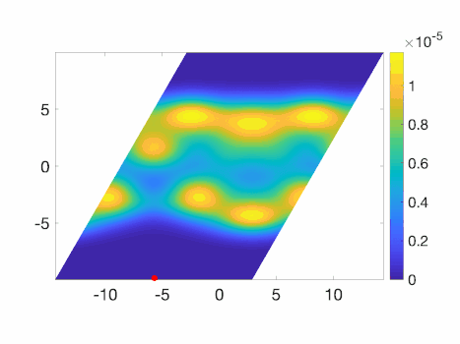
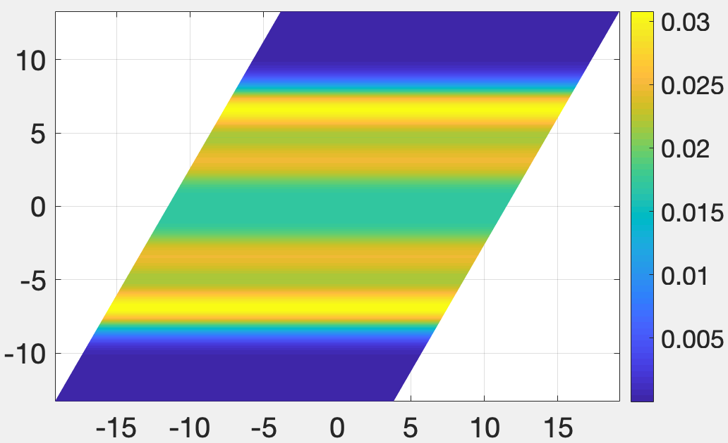
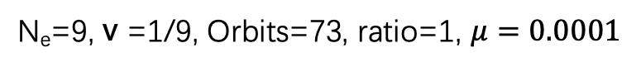
N_{e}=9, v =1/9, Orbits=73, ratio=1, $μ=0.0001$
Pair correlation function
Left Fig: electron density profile
Right Fig: Pair correlation function

